Slide 1

Meta-Learning with Memory-Augmented Neural Networks
Santoro, Adam; Bartunov, Sergey; Botvinick, Matthew; Wierstra, Daan; Lillicrap, Timothy
Presented By : David Ishak Kosasih

Slide 2
Outline
Introduction
Meta-Learning Task Methodology
Memory-Augmented Model
3.1 Neural Turing Machines
3.2 Least Recently Used Access
Experimental Results
4.1 Data
4.2 Omniglot Classification
4.2.1 Persistent Memory Interference
4.2.2 Curriculum Training
Conclusion

Slide 3
Introduction
Current deep learning algorithm relies on gradient-based optimization to high-capacity models, such as:
Delving deep into rectiﬁers: Surpassing human level performance on imagenet classiﬁcation by He, Kaiming, Zhang, Xiangyu, Ren, Shaoqing, and Sun, Jian
Automatic Speech Recognition by Yu, Dong and Deng, Li
Human-level control through deep reinforcement learning by Mnih, Volodymyr, Kavukcuoglu, Koray, Silver, David, Rusu, Andrei A, Veness, Joel, Bellemare, Marc G, Graves, Alex, Riedmiller, Martin, Fidjeland, Andreas K, Ostrovski, Georg, et al.
Downside of traditional gradient-based networks:
Require a lot of data
Models need to relearn their parameters when encounter new data
Expectation:
Flexible Adaptation, such as:
One-shot learning

Slide 4
Introduction
Solution:
Meta-learning
Neural network with memory capacities could prove quite capable of meta-learning, such as LSTMs
Problem:
Unreliable when each new task requires significant amounts of new information to be rapidly encoded
Requirement for scalable solutions:
Information must be stored in stable and element-wise addressable memory
Number of parameter should not be tied to the size of the memory

Slide 5
Introduction
Proposed method:
Memory-augmented neural network (MANN)
Approach:
Ability to slowly learn an abstract method for obtaining useful representations of raw data, via gradient descent
Ability to rapidly bind never-before- seen information after a single presentation, via an external memory module
Notes:
This work based on Neural Turing Machines (NTMs)

Slide 6
Meta-Learning Task Methodology
Normal machine learning approach | Meta learning approach
Choose parameters θ to minimize a learning cost α across some dataset D | Choose parameters to reduce the expected learning cost across a distribution of datasets p(D)
θ∗ = argmin_{θ}E_{D∼p(D)}[L(D; θ)]

Slide 7
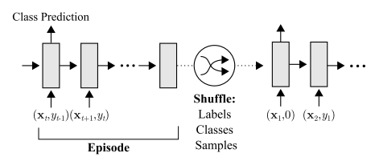

Meta-Learning Task Methodology
Task setup:
$D={\left\{ⅆ_{t}\right\}}_{t=1}^{T}={\left\{\left(x_{t},y_{t}\right)\right\}}_{t=1}^{T}$
yt is both a target, and is presented as input along with xt that is (x₁, null), (x₂, y₁), . . . , (x_{T}, y_{T−1})
Therefore, at time t, correct label for the previous data sample (y_{t−1}) is provided as input along with new query x_{t}
Notes:
Omniglot images (or x-values for regression), xt, are presented with time-offset labels (or function values), y_{t−1}, to prevent the network from simply mapping the class labels to the output. From episode to episode, the classes to be presented in the episode, their associated labels, and the specific samples are all shuffled.

Slide 8
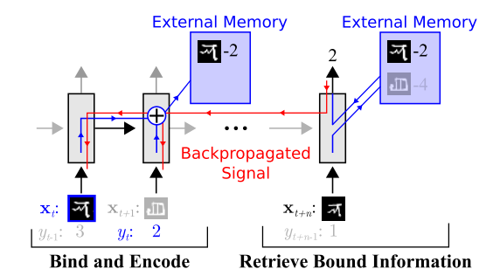
Meta-Learning Task Methodology
Task setup:
Labels are shuffled and it must learn to hold data samples in memory until the appropriate labels are presented at the next timestep, after which sample-class information can be bound and stored for later use
Notes:
A successful strategy would involve the use of an external memory to store bound sample representation-class label information, which can then be retrieved at a later point for successful classification when a sample from an already-seen class is presented. Specifically, sample data x_{t} from a particular time step should be bound to the appropriate class label y_{t}, which is presented in the subsequent time step. Later, when a sample from this same class is seen, it should retrieve this bound information from the external memory to make a prediction.

Slide 9
Memory-Augmented Model
3.1 Neural Turing Machines
3.2 Least Recently Used Access

Slide 10
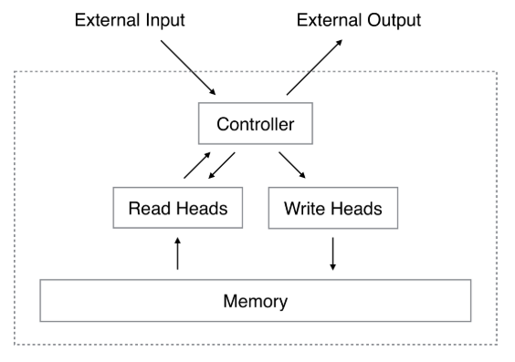



3.1 Neural Turing Machines
The Neural Turing Machine is a fully differentiable implementation of a MANN.
Cosine similarity measure:
Generating read weight vector:
Retrieving memory:

Slide 11

3.2 Least Recently Used Access
The LRUA module is content-based memory writer that writes memories to:
The least used memory location
The most recently used memory location (update)
Computing Usage weight:
Usage
Weight
Decay
parameter
Read
Weight
Write
Weight

Slide 12


3.2 Least Recently Used Access
Obtaining least-used weight :
Computing write weight:
Number of reads
to memory
Least-used
Weight

Slide 13

3.2 Least Recently Used Access
Writing to memory:
Therefore, memories can be written into:
the zeroed memory slot
the previously used slot (the least used memories get erased)

Slide 14
Experimental Results
4.1 Data
4.2 Omniglot Classification

Slide 15
4.1 Data
Source of data:
Omniglot
1623 separate classes → 1200 (training) & 423 (testing)
Data augmentation by randomly translating and rotating character image

Slide 16
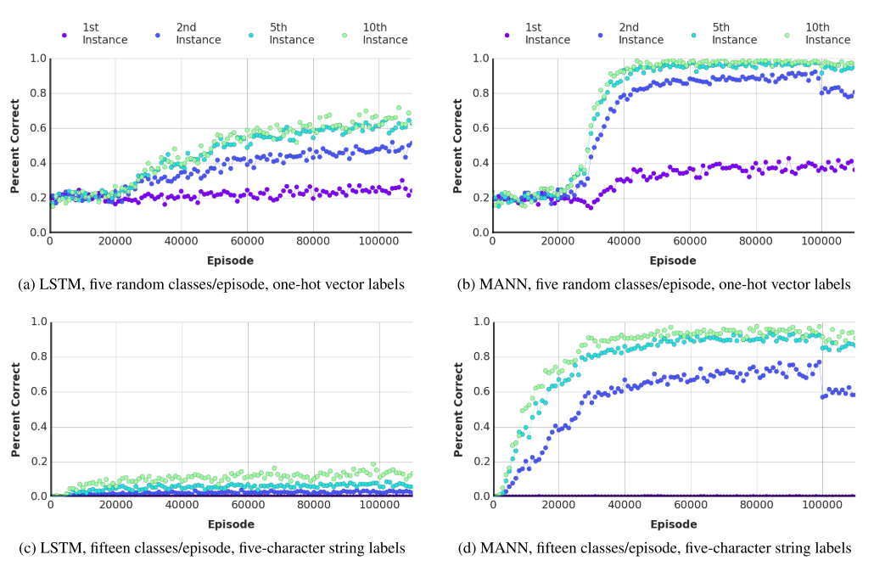
4.2 Omniglot Classification

Slide 17
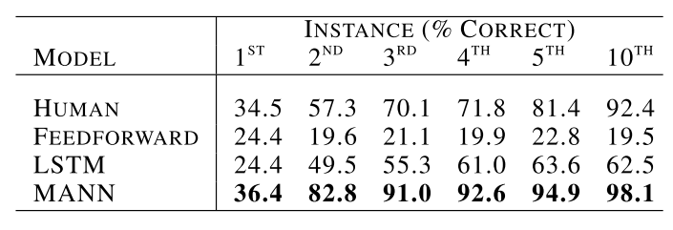
4.2 Omniglot Classification

Slide 18
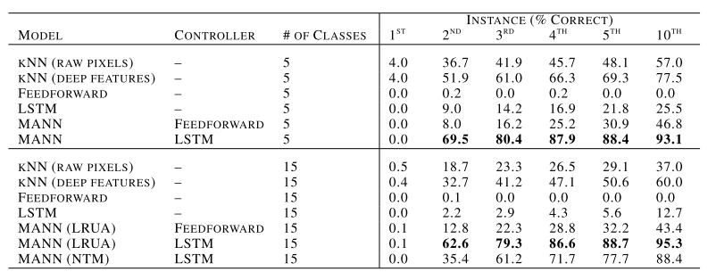
4.2 Omniglot Classification

Slide 19
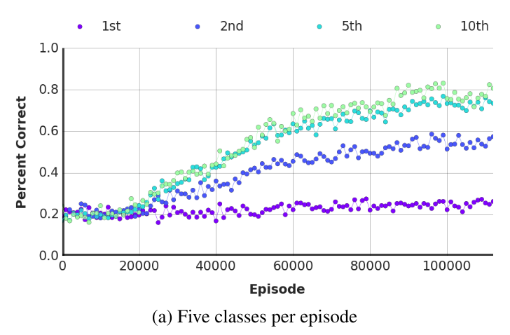
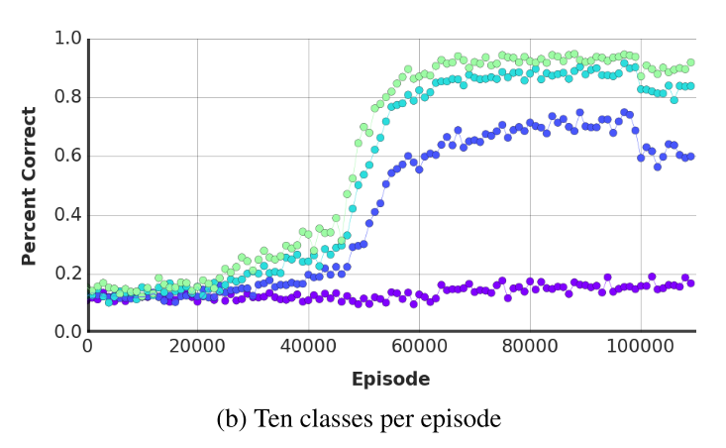
4.2 Omniglot Classification
4.2.1 Persistent memory interference

Slide 20
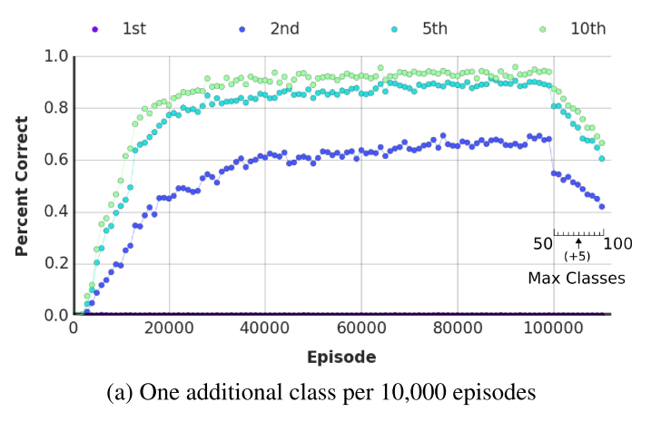
4.2 Omniglot Classification
4.2.2 Curriculum training

Slide 21
Conclusion
MANN performed better than LSTM
MANN suffers from proactive interference, when memory is not cleared between tasks

Slide 22
감사합니다 Thank You

